Slide 1


Comparison & Contrast
Unit 6

Slide 2

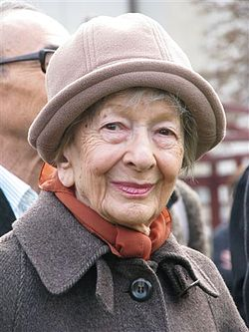
“Get to know other worlds,
if only for comparison.”
Wislawa Szymborska
Polish Poet

Slide 3
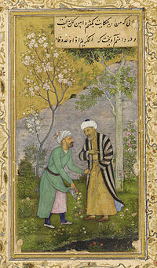
“The rose and the thorn,
and sorrow and gladness
are linked together.”
Saadi
Persian Poet

Slide 4
Purpose
To present something unfamiliar by comparing it with something familiar
To show the superiority of one thing by comparing it with another
To show similarities & differences of two things

Slide 5
Methods
COMPARISON & CONTRAST METHODS
Point-by-Point (Itemized)
  → Horizontal
Block
  → Vertical

Slide 6


Example
Discuss differences between vacationing
at the beach or in the mountains

Slide 7
Point-by-Point
Point-by-Point
Procedure Compare and contrast one specific point -- first regarding one subject, then the other. Next, compare another specific point – again, regarding one subject, then the other. Example (see TABLE 1) First, discuss the similarities or differences of the climate at the beach and the mountain. Second, discuss the similarities or differences of the activities at the beach and the mountain. Last, discuss the similarities or differences of the location regarding the beach and the mountain.

Slide 8
Point-by-Point
Point-by-Point (TABLE 1)
1) | FIRST Difference = Climate A. Mountains B. Beach
2) | SECOND Difference = Activities A. Mountains B. Beach
3) | THIRD Difference = Location A. Mountains B. Beach

Slide 9
Block Style
Block Style
Procedure Discuss all specific points of the first subject. Next, discuss all the specific points of the second subject. Example (see TABLE 2) First, discuss specific details of climate, activities, and location of the beach. Second, discuss specific details of climate, activities, and location of the mountain.

Slide 10
Block
Block (TABLE 2)
1) | BEACH A. Climate B. Activities C. Location
2) | MOUNTAIN A. Climate B. Activities C. Location

Slide 11
Assignment
Group Presentation
Identify 5 different websites
→ Which offer similar service or info
Choose 2 to compare & contrast
  Use either Horizontal or Vertical style
Decide on 1 to recommend to the class

Slide 12
Assignment
Group Presentation
Your group will give a 5-minute presentation regarding comparison & contrast.
First, your presentation will identify 5 websites that offer similar service or information.
→ Dating website, Travel, News, etc.
Next, your presentation will compare & contrast 2 of those websites.
→ Use either the Point-by-Point or Block style
Last, your group will recommend 1 website as the best choice for the class.

